Slide 1
DASC 5301-002
Clustering
Dr Subharag Sarkar
Fall 2023
Slides Courtesy - Rózsa Záruba

Slide 2
Supervised and Unsupervised Learning
Supervised learning: discover patterns in the data that relate data attributes with a target (class) attribute.
These patterns are then utilized to predict the values of the target attribute in future data instances.
Unsupervised learning: The data have no target attribute.
We want to explore the data to find some intrinsic structures in them.

Slide 3
Unsupervised machine learning
The machine learning task of inferring a function to describe hidden structure from ‘unlabeled’ data (class or category is not included)

Slide 4
Clustering

Slide 5
Clustering
Clustering is a technique for finding similarity groups in data, called clusters. i.e.,
It groups data instances that are similar to (near) each other in one cluster and data instances that are very different (far away) from each other into different clusters.
Clustering is often called an unsupervised learning task as no class values denoting an apriori grouping of the data instances are given, which is the case in supervised learning.
Due to historical reasons, clustering is often considered synonymous with unsupervised learning.
In fact, association rule mining is also unsupervised

Slide 6
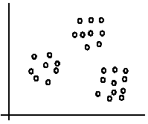
Illustration
The data set has three natural groups of data points, i.e., 3 natural clusters.

Slide 7
Why cluster?
Labeling is expensive
Gain insight into the structure of the data
Find prototypes in the data

Slide 8
What is Clustering for?
Let us see some real-life examples
Example 1: Group people of similar sizes together to make “small”, “medium” and “large” T-Shirts.
Tailor-made for each person: too expensive
One-size-fits-all: does not fit all.
Example 2: In marketing, segment customers according to their similarities
To do targeted marketing.

Slide 9
What is Clustering for?
Example 3: Given a collection of text documents, we want to organize them according to their content similarities,
To produce a topic hierarchy
In fact, clustering is one of the most utilized data mining techniques.
It has a long history, and used in almost every field, e.g., medicine, psychology, botany, sociology, biology, archeology, marketing, insurance, libraries, etc.
In recent years, due to the rapid increase of online documents, text clustering becomes important.

Slide 10
Goals of Clustering
Clustering has one or more goals:
It Segments a large set of cases into small subsets that can be treated similarly - segmentation
Generates a more compact description of a dataset - compression
Models an underlying process that generates the data as a mixture of different, localized processes – representation

Slide 11
Goal of Clustering
Given a set of data points, each described by a set of attributes, find clusters such that:
Inter-cluster similarity is maximized
Intra-cluster similarity is minimized
Requires the definition of a similarity measure
F1
x
x
x
x
x
x
x
x
xx
x
x
x
x
x
x
xx
x
F2
Notes:
Data

Slide 12
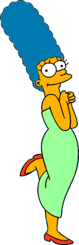



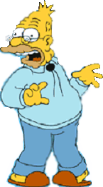
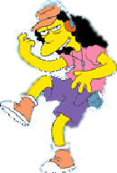


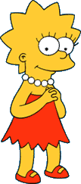
What is a natural grouping of these objects?
Slide from Eamonn Keogh

Slide 13
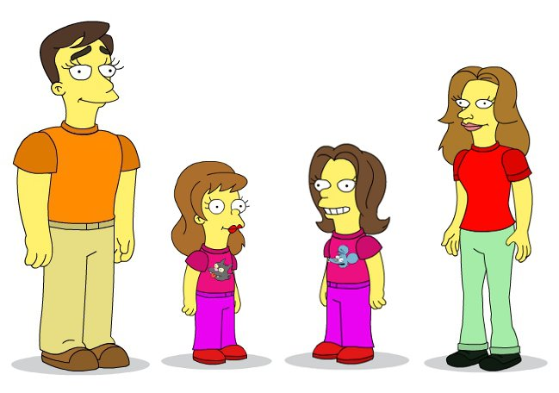
10 years ago

Slide 14




What is a natural grouping of these objects?
Slide from Eamonn Keogh
Clustering is Subjective
Simpson's Family
School Employees
Females
Males

Slide 15
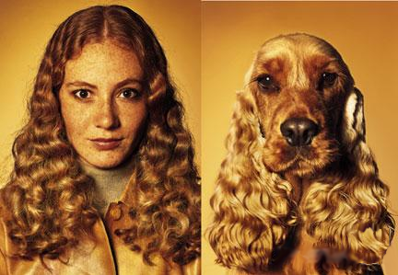
What is Similarity?
Slide based on one by Eamonn Keogh
Similarity is hard to define, but…
“We know it when we see it”

Slide 16
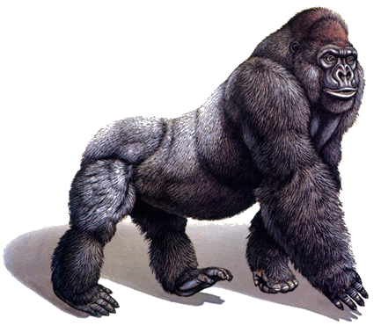
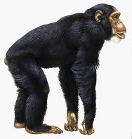
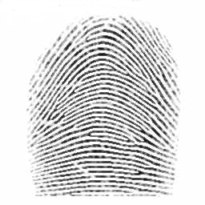
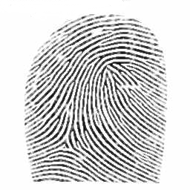
Defining Distance Measures
Slide from Eamonn Keogh
Definition: Let O₁ and O₂ be two objects from the universe of possible objects. The distance (dissimilarity) between O₁ and O₂ is a real number denoted by D(O₁,O₂)
Peter
Piotr
0.23
3
342.7

Slide 17
What properties should a distance measure have?
D(A,B) = D(B,A) Symmetry
D(A,A) = 0 Constancy of Self-Similarity
D(A,B) = 0 iif A= B Positivity (Separation)
D(A,B) ≤ D(A,C) + D(B,C) Triangular Inequality
Slide based on one by Eamonn Keogh

Slide 18
Intuitions behind desirable distance measure properties
Slide based on one by Eamonn Keogh
D(A,B) = D(B,A) Symmetry
Otherwise you could claim “Alex looks like Bob, but Bob looks nothing like Alex.”
D(A,A) = 0 Constancy of Self-Similarity
Otherwise you could claim “Alex looks more like Bob, than Bob does.”

Slide 19
Intuitions behind desirable distance measure properties (continued)
Slide based on one by Eamonn Keogh
D(A,B) = 0 IIf A=B Positive (separation)
Otherwise there are objects in your world that are different, but you cannot tell apart.
D(A,B) ≤ D(A,C) + D(B,C) Triangular Inequality
Otherwise you could claim “Alex is very like Bob, and Alex is very like Carl, but Bob is very unlike Carl.”

Slide 20


Two Types of Clustering
Partitional algorithms: Construct various partitions and then evaluate them by some criterion
Hierarchical algorithms: Create a hierarchical decomposition of the set of objects using some criterion
Hierarchical
Partitional
Notes:
Have class break into groups and invent clustering algorithms.

Slide 21
Desirable Properties of a Clustering Algorithm
Scalability (in terms of both time and space)
Ability to deal with different data types
Minimal requirements for domain knowledge to determine input parameters
Able to deal with noise and outliers
Insensitive to order of input records
Incorporation of user-specified constraints
Interpretability and usability

Slide 22
Dendogram: A Useful Tool for Summarizing Similarity Measurements
Slide based on one by Eamonn Keogh
The similarity between two objects in a dendrogram is represented as the height of the lowest internal node they share.

Slide 23
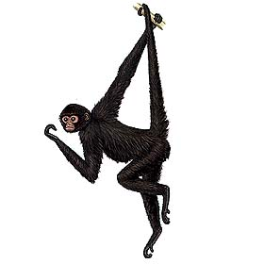
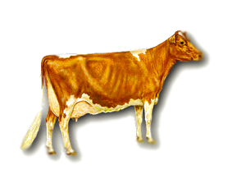
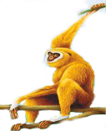
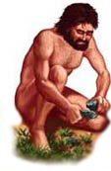
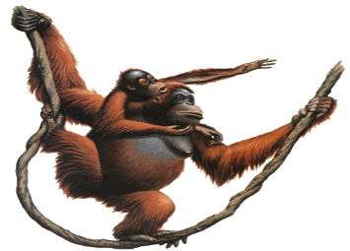
There is only one dataset that can be perfectly clustered using a hierarchy…
(Bovine:0.69395, (Spider Monkey 0.390, (Gibbon:0.36079,(Orang:0.33636,(Gorilla:0.17147,(Chimp:0.19268, Human:0.11927):0.08386):0.06124):0.15057):0.54939);
Slide based on one by Eamonn Keogh

Slide 24

Note that hierarchies are commonly used to organize information, for example in a web portal.
Yahoo’s hierarchy is manually created, we will focus on automatic creation of hierarchies in data mining.
Business & Economy
B2B Finance Shopping Jobs
Aerospace Agriculture… Banking Bonds… Animals Apparel Career Workspace

Slide 25











Hierarchal clustering can sometimes show patterns that are meaningless or spurious
The tight grouping of Australia, Anguilla, St. Helena etc is meaningful; all these countries are former UK colonies
However, the tight grouping of Niger and India is completely spurious; there is no connection between the two.
South Georgia &
South Sandwich
Islands
Serbia &
Montenegro
(Yugoslavia)
AUSTRALIA
St. Helena &
Dependencies
ANGUILLA
U.K.
FRANCE
NIGER
INDIA
IRELAND
BRAZIL

Slide 26
South Georgia &
South Sandwich
Islands
Serbia &
Montenegro
(Yugoslavia)
AUSTRALIA
St. Helena &
Dependencies
ANGUILLA
U.K.
FRANCE
NIGER
INDIA
IRELAND
BRAZIL
Notes:
The flag of Niger is orange over white over green, with an orange disc on the central white stripe, symbolizing the sun. The orange stands the Sahara desert, which borders Niger to the north. Green stands for the grassy plains of the south and west and for the River Niger which sustains them. It also stands for fraternity and hope. White generally symbolizes purity and hope.
The Indian flag is a horizontal tricolor in equal proportion of deep saffron on the top, white in the middle and dark green at the bottom. In the center of the white band, there is a wheel in navy blue to indicate the Dharma Chakra, the wheel of law in the Sarnath Lion Capital. This center symbol or the 'CHAKRA' is a symbol dating back to 2nd century BC. The saffron stands for courage and sacrifice; the white, for purity and truth; the green for growth and auspiciousness.

Slide 27
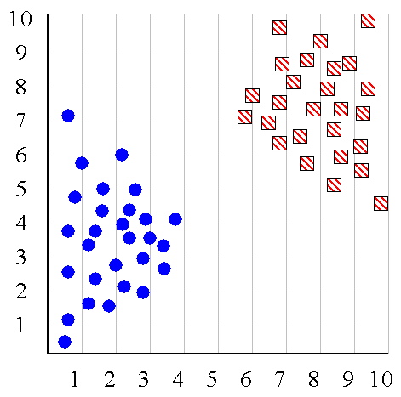
We can look at the dendrogram to determine the “correct” number of clusters.
Notes:
In this case, the two highly separated subtrees are highly suggestive of two clusters. (Things are rarely this clear cut, unfortunately)

Slide 28
One potential use of a dendrogram: detecting outliers
The single isolated branch is suggestive of a data point that is very different to all others
Outlier

Slide 29
Hierarchical Clustering
The number of dendrograms with n
leafs = (2n -3)!/[(2^{(n -2)}) (n -2)!]
Number Number of Possible
of Leafs Dendrograms
2 1
3 3
4 15
5 105
... …
34,459,425
Since we cannot test all possible trees, we will have to heuristic search of all possible trees. We could do this..
Bottom-Up (agglomerative): Starting with each item in its own cluster, find the best pair to merge into a new cluster. Repeat until all clusters are fused together.
Top-Down (divisive): Starting with all the data in a single cluster, consider every possible way to divide the cluster into two. Choose the best division and recursively operate on both sides.

Slide 30


We begin with a distance matrix which contains the distances between every pair of objects in our database.
0
8
8
7
7
D( , ) = 8
D( , ) = 1
0
2
4
4
0
3
3
0
1
0

Slide 31

Bottom-Up (agglomerative): Starting with each item in its own cluster, find the best pair to merge into a new cluster. Repeat until all clusters are fused together.
Consider all possible merges…
Choose the best
…

Slide 32
Bottom-Up (agglomerative): Starting with each item in its own cluster, find the best pair to merge into a new cluster. Repeat until all clusters are fused together.
Consider all possible merges…
Choose the best
…
Consider all possible merges…
Choose the best
…

Slide 33
Bottom-Up (agglomerative): Starting with each item in its own cluster, find the best pair to merge into a new cluster. Repeat until all clusters are fused together.
Consider all possible merges…
Choose the best
…
Consider all possible merges…
Choose the best
…
Consider all possible merges…
Choose the best
…

Slide 34

Bottom-Up (agglomerative): Starting with each item in its own cluster, find the best pair to merge into a new cluster. Repeat until all clusters are fused together.
Consider all possible merges…
Choose the best
…
Consider all possible merges…
Choose the best
…
Consider all possible merges…
Choose the best
…

Slide 35
Calculating Distance
Single linkage (nearest neighbor): In this method the distance between two clusters is determined by the distance of the two closest objects (nearest neighbors) in the different clusters.
Complete linkage (furthest neighbor): In this method, the distances between clusters are determined by the greatest distance between any two objects in the different clusters (i.e., by the "furthest neighbors").
Group average linkage: In this method, the distance between two clusters is calculated as the average distance between all pairs of objects in the two different clusters.
Notes:
Start -> We know how to measure the distance between two objects, but defining the distance between an object and a cluster, or defining the distance between two clusters is non obvious.

Slide 36
Slide based on one by Eamonn Keogh
Single linkage
Average linkage

Slide 37
Hierarchal Clustering Methods Summary
No need to specify the number of clusters in advance
Hierarchal nature-> maps nicely onto human intuition for some domains
They do not scale well: time complexity of at least O(n²), where n is the number of total objects
Like any heuristic search algorithms, local optima are a problem
Interpretation of results is (very) subjective

Slide 38
How do we measure similarity?
Peter
Piotr
0.23
3
342.7
Notes:
Up to this point we have simply assumed that we can measure similarity, but

Slide 39
A generic technique for measuring similarity
To measure the similarity between two objects, transform one into the other, and measure how much effort it took. The measure of effort becomes the distance measure.
The distance between Patty and Selma:
Change dress color, 1 point
Change earring shape, 1 point
Change hair part, 1 point
D(Patty,Selma) = 3
The distance between Marge and Selma:
Change dress color, 1 point
Add earrings, 1 point
Decrease height, 1 point
Take up smoking, 1 point
Lose weight, 1 point
D(Marge,Selma) = 5
This is called the “edit distance” or the “transformation distance”

Slide 40
Edit Distance Example
How similar are the names “Peter” and “Piotr”?
Assume the following cost function Substitution 1 Unit
Insertion 1 Unit
Deletion 1 Unit
D(Peter,Piotr) is 3
It is possible to transform any string Q into string C, using only Substitution, Insertion and Deletion.
Assume that each of these operators has a cost associated with it.
The similarity between two strings can be defined as the cost of the cheapest transformation from Q to C.
Peter
Piter
Pioter
Piotr
Substitution (i for e)
Insertion (o)
Piotr
Pyotr
Pedro
Piero
Peter
Petros
Pietro
Pierre
Deletion (e)
Notes:
Note that for now we have ignored the issue of how we can find this cheapest transformation

Slide 41







Partitional Clustering
Nonhierarchical, each instance is placed in exactly one of K non-overlapping clusters.
Since only one set of clusters is output, the user normally has to input the desired number of clusters K.

Slide 42
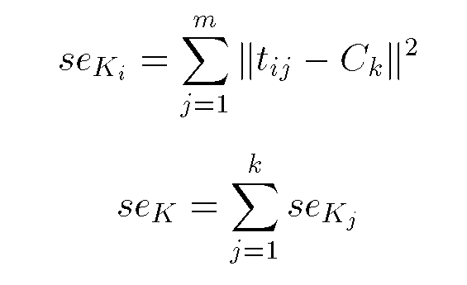
Squared Error
10
9
8
7
6
5
4
3
Objective Function
2
1
1
2
3
4
5
6
7
8
9
10
Notes:
in mathematics, the Euclidean distance between two points in Euclidean space is the length of a line segment between the two points. It can be calculated from the Cartesian coordinates of the points using the Pythagorean theorem, therefore occasionally being called the Pythagorean distance.

Slide 43
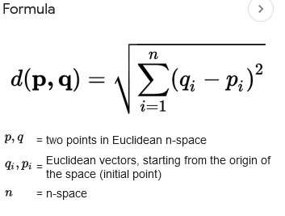
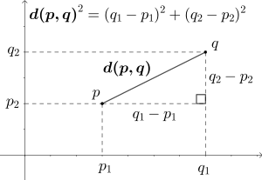
Eucledian Distance
https://en.wikipedia.org/wiki/Euclidean_distance
Notes:
n mathematics, the Euclidean distance between two points in Euclidean space is the length of a line segment between the two points. It can be calculated from the Cartesian coordinates of the points using the Pythagorean theorem, therefore occasionally being called the Pythagorean distance.

Slide 44
K-means clustering
The standard k-means algorithm is based on Euclidean distance.
The cluster quality measure is an intra-cluster measure only, equivalent to the sum of item-to-centroid kernels.
A simple greedy algorithm locally optimizes this measure (usually called Lloyd’s algorithm):
Find the closest cluster center for each item and assign it to that cluster.
Recompute the cluster centroid as the mean of items, for the newly-assigned items in the cluster.

Slide 45
Partition Algorithm: k-means
1. Decide on a value for k.
2. Initialize the k cluster centers (randomly, if necessary).
3. Decide the class memberships of the N objects by assigning them to the nearest cluster center.
4. Re-estimate the k cluster centers, by assuming the memberships found above are correct.
5. If none of the N objects changed membership in the last iteration, exit. Otherwise goto 3.

Slide 46
K-means clustering
Cluster centers – can pick by sampling the input data.

Slide 47
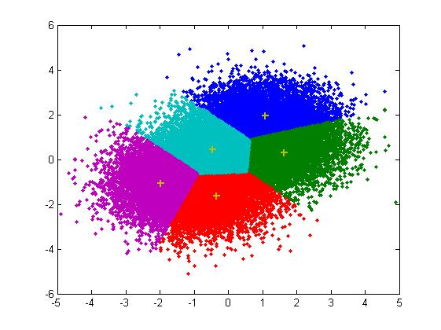
K-means clustering
Assign points to closest center

Slide 48
K-means clustering
Recompute centers (old = cross, new = dot)

Slide 49
Stopping criteria for k-means
no (or minimum) re-assignments of data points to different clusters,
no (or minimum) change of centroids, or
minimum decrease in the sum of squared error (SSE),

Slide 50
K-means Clustering: Step 1
Algorithm: k-means, Distance Metric: Euclidean Distance
5
4
k₁
3
k₂
2
1
k₃
0
0
1
2
3
4
5

Slide 51
K-means Clustering: Step 2
Algorithm: k-means, Distance Metric: Euclidean Distance
5
4
k₁
3
k₂
2
1
k₃
0
0
1
2
3
4
5

Slide 52
K-means Clustering: Step 3
Algorithm: k-means, Distance Metric: Euclidean Distance
5
4
k₁
3
2
k₃
k₂
1
0
0
1
2
3
4
5

Slide 53
K-means Clustering: Step 4
Algorithm: k-means, Distance Metric: Euclidean Distance
5
4
k₁
3
2
k₃
k₂
1
0
0
1
2
3
4
5

Slide 54
K-means Clustering: Step 5
k₁
k₂
k₃

Slide 55
Comments on k-Means
Strengths
Relatively efficient: O(tkn), where n is # objects, k is # clusters, and t is # iterations. Normally, k, t << n.
Often terminates at a local optimum.
Weakness
Applicable only when mean is defined, then what about categorical data? For categorical data, k-mode - the centroid is represented by most frequent values.
Need to specify k, the number of clusters, in advance
Unable to handle noisy data and outliers
Not suitable to discover clusters with non-convex shapes

Slide 56
Elbow Method
The elbow method is a useful graphical tool to estimate the optimal number of clusters k for a given task. Intuitively, we can say that, if k increases, the within-cluster SSE (“distortion”) will decrease. This is because the samples will be closer to the centroids they are assigned to.
The idea behind the elbow method is to identify the value of k where the distortion begins to decrease most rapidly, which will become clearer if we plot the distortion for different values of k:

Slide 57
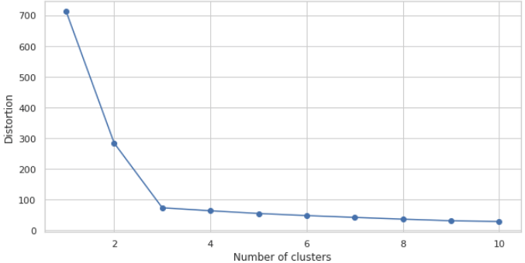
K=3

Slide 58
The K-Medoids Clustering Method
In K-medoids Clustering, instead of taking the centroid of the objects in a cluster as a reference point as in k-means clustering, we take the medoid as a reference point. A medoid is a most centrally located object in the Cluster or whose average dissimilarity to all the objects is minimum. Hence, the K-medoids algorithm is more robust to noise than the K-means algorithm
PAM (Partitioning Around Medoids, 1987)
starts from an initial set of medoids and iteratively replaces one of the medoids by one of the non-medoids if it improves the total distance of the resulting clustering
PAM works effectively for small data sets, but does not scale well for large data sets

Slide 59
Nearest Neighbor Clustering
Not to be confused with Nearest Neighbor Classification
Items are iteratively merged into the existing clusters that are closest.
Incremental
Threshold, t, used to determine if items are added to existing clusters or a new cluster is created.

Slide 60
How do we measure similarity?
Peter
Piotr
0.23
3
342.7

Slide 61
What distance metric did k-means use?
What assumptions is it making about the data?
Notes:
Assuming all features are important
normalized

Slide 62
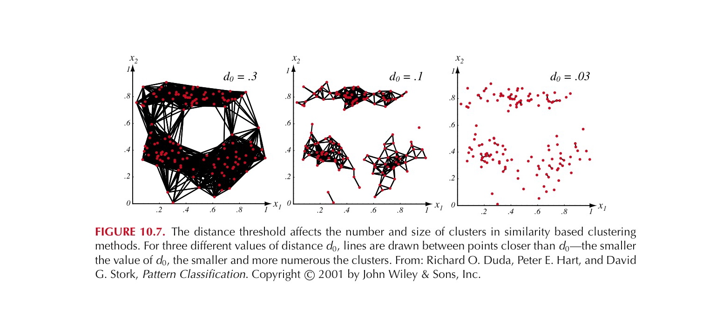
Partition Algorithm 2: Using a Euclidean Distance Threshold to Define Clusters
Notes:
If we say that two examples belong to the same cluster if the Euclidean distance bwtween them is less than some distance d_o. It is immediately obvious that the choice of d_o is
critical. If d_o is large all of the samples will be assigned to one cluster, if d_o is very small each sample will form an isolated singleton cluster. To obtain natural clusters, d_o will have to be greater than the typical within cluster distances and less than the typical between cluster distances.

Slide 63
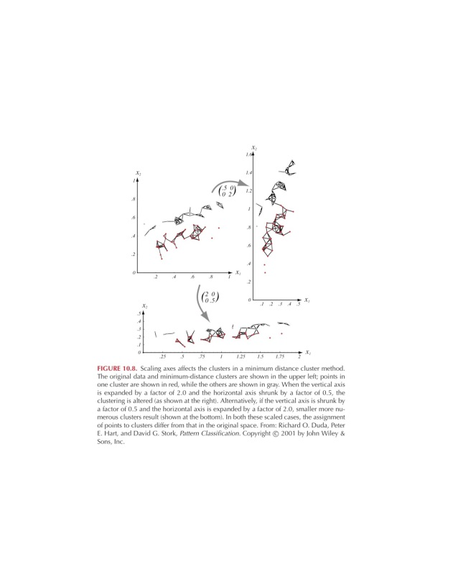
But should we use Euclidean Distance?
Good if data is isotropic and spread evenly along all directions
Not invariant to linear transformations, or any transformation that distorts distance relationships
Notes:
Isotropic means uniform in all directions
Figure shows that simple scaling of the coordinate axes can result in a different grouping of the data into clusters.
One way to achieve invariance is to normalize the data before clustering!!!

Slide 64
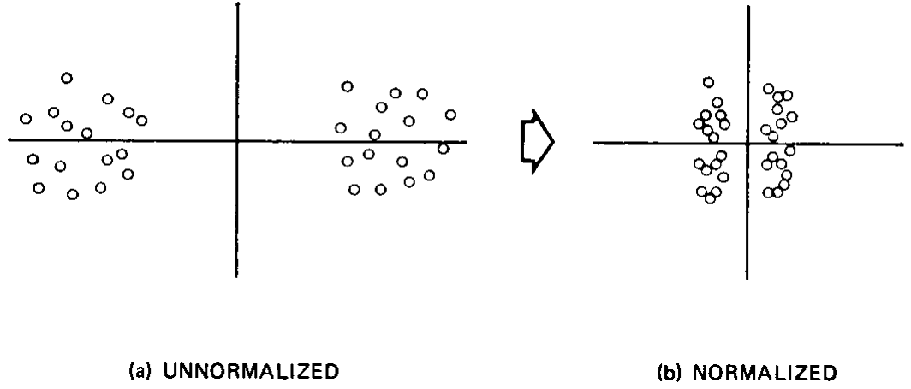
Is normalization desirable?

Slide 65
Other distance/similarity measures
Distance between two instances x and x’, where q >= 1 is a selectable parameter and d is the number of attributes (called the Minkowski Metric)
Q = 1 we have the manhattan distance, if q = 2 we have the euclidean distance….
Cosine of the angle between two vectors (instances) gives
a similarity function:

Slide 66
Other distance/similarity measures
Distance between two instances x and x’, where q >= 1 is a selectable parameter and d is the number of attributes (called the Minkowski Metric)
When features are binary
this becomes the number of attributes shared by x and x’ divided by the geometric mean of the number of attributes in x and the number in x’. A simplification of this is:
Cosine of the angle between two vectors (instances) gives
a similarity function:
Notes:
Q = 1 we have the manhattan distance, if q = 2 we have the euclidean distance….

Slide 67
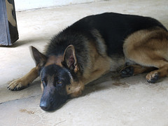

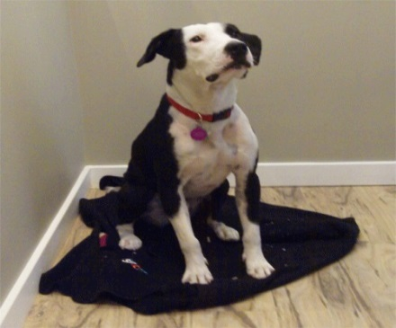
“Cluster Bias”
Human beings conceptualize the world through categories represented as examplars (Rosch 73, Estes 94).
We tend to see cluster structure whether it is there or not.
Works well for dogs, but…

Slide 68
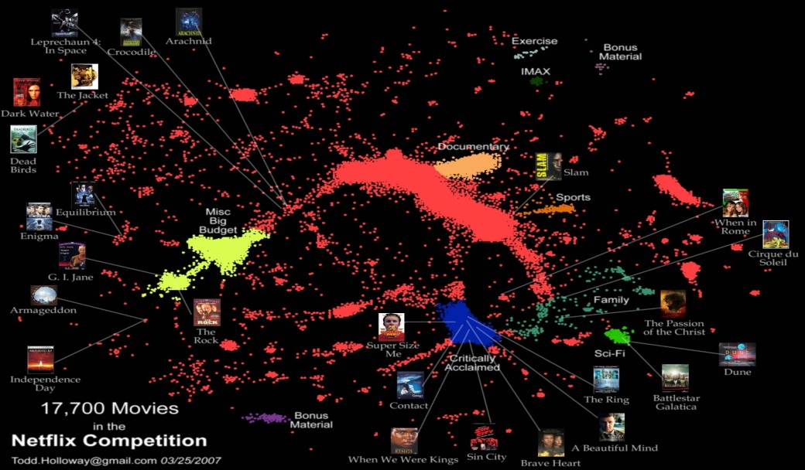
Netflix
More of a continuum than discrete clusters
Factor models, kNN do much better than discrete cluster models.

Slide 69
“Cluster Bias”
Upshot:
Clustering is used more than it should be, because people assume an underlying domain has discrete classes in it.
This is especially true for characteristics of people, e.g. Myers-Briggs personality types like “ENTP”.
In reality the underlying data is usually continuous.
Just as with Netflix, continuous models (dimension reduction, kNN) tend to do better.

Slide 70
Terminology
Hierarchical clustering: clusters form a hierarchy. Can be computed bottom-up or top-down.
Flat clustering: no inter-cluster structure.
Hard clustering: items assigned to a unique cluster.
Soft clustering: cluster membership is a real-valued function, distributed across several clusters.

